Slide 1
In Order to Lean In, You Have to Be at the Table
Angela Sharkey, MD
Associate Dean of Faculty Affairs and Professional Development
Professor of Pediatrics
Saint Louis University School of Medicine
Past chair, AAMC Group on Women in Medicine and Science

Slide 2
How are we influenced by society?
What does a woman leader look like?
How does a woman leader behave?
How does this impact the ability of women to achieve leadership roles?
How does this effect your decisions to hire/promote?
Notes:
Personal resilience, mentors, and a knack for creating opportunity are among the tools used by women-of-color executives to break down the “concrete ceiling.”

Slide 3
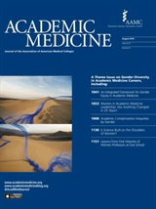
Aug 2016 issue

Slide 4
Notes:
There is much to be learned from the business industry in this regard as well.
Women face unique challenges in being perceived as leaders. In order to provide a better context of the issue, we will first review the data of the status of FULL TIME women faculty at your institution.

Slide 5
UMMC Group on Women in Medicine and Science
Jennifer M. Sasser, PhD
Department of Pharmacology and Toxicology
GWIMS@umc.edu

Slide 6
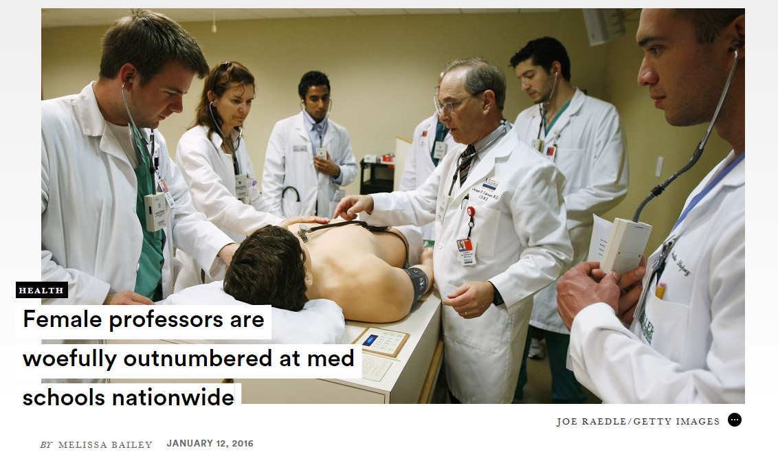

Slide 7
The State of Women in Academic Medicine: The Pipeline and Pathways to Leadership National results and benchmarking presentation
The presentation template was created by Claudia Raezer, Program Specialist, Women in Medicine and Science and Diana Lautenberger, M.A.T., Director, Women in Medicine and Science, Association of American Medical Colleges.
Notes:
Data collection process – and who might be missed (i.e. part time, adjunct, etc)

Slide 8
How are we doing?

Slide 9
Total Full Time Faculty
Source: Women in Medicine and Science Benchmarking Tables, Table 7

Slide 10
Full-Time Full Professors and Tenured Faculty
Source: Women in Medicine and Science Benchmarking Tables, Table 7

Slide 11
Full-Time Full Professors by Gender
Source: Women in Medicine and Science Benchmarking Tables, Table 7
Notes:
Tenured faculty tend to be promoted to leadership roles – this distribution disadvantages women in this regard.

Slide 12
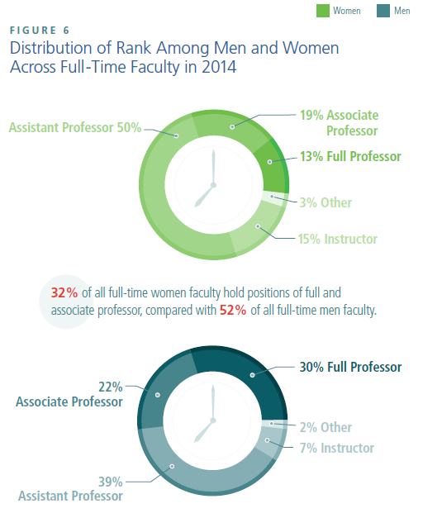
UMMC SOM
Notes:
Do you have data on the % distribution in rank for SOM faculty? Is there someplace I can get this – like from Patrick Smith??

Slide 13
Promotions and Tenure for Full-Time Faculty
Source: Women in Medicine and Science Benchmarking Tables, Table 8
Notes:
Many more men start on tenure line positions than their female colleagues – how does this impact leadership opportunities for women faculty? How does this influence what committee work women faculty can do? How does it therefore influence visibility of women faculty at an institutional level?

Slide 14
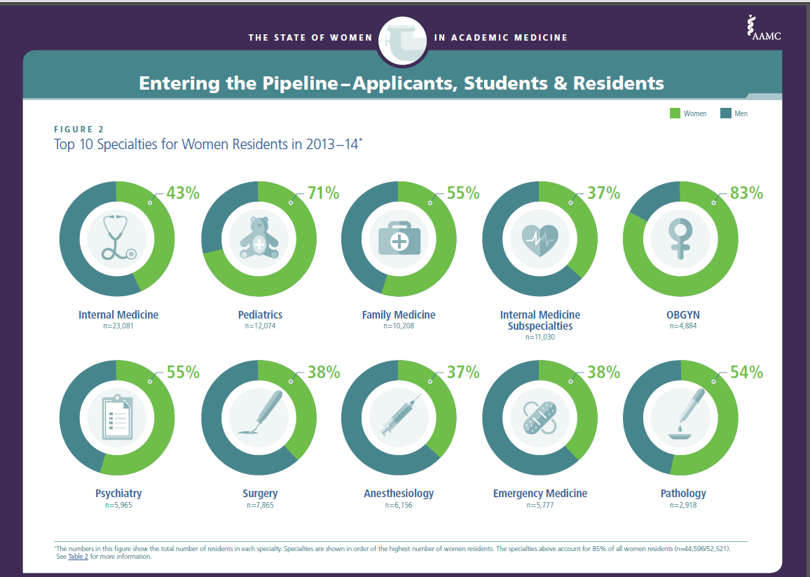

Slide 15
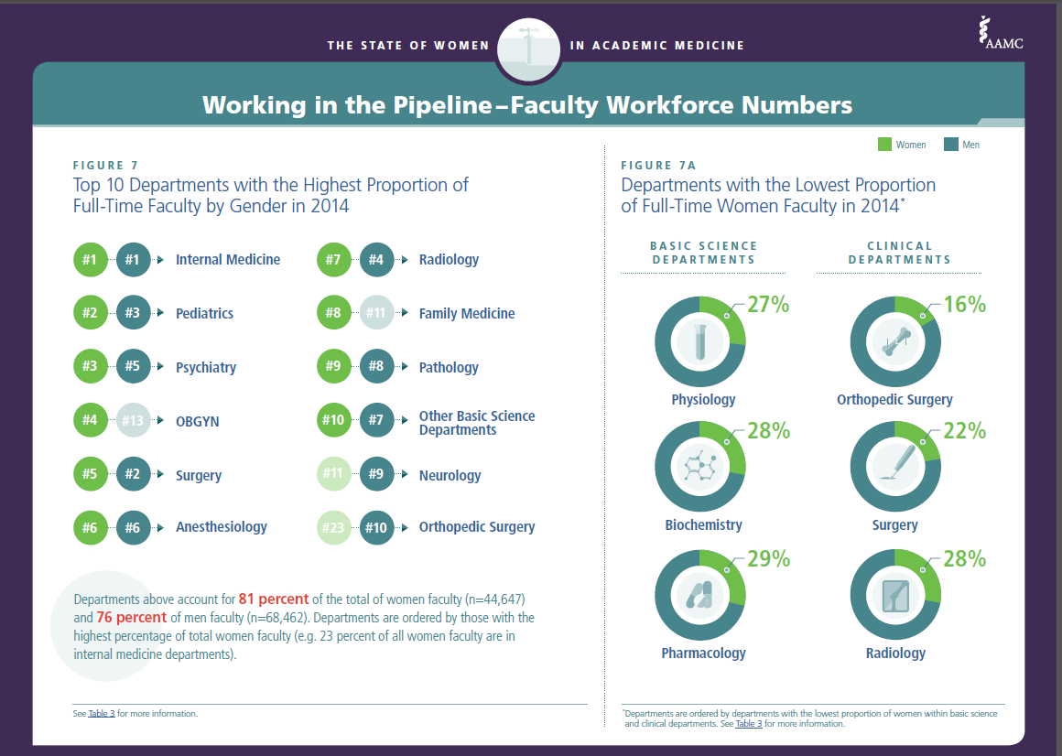

Slide 16
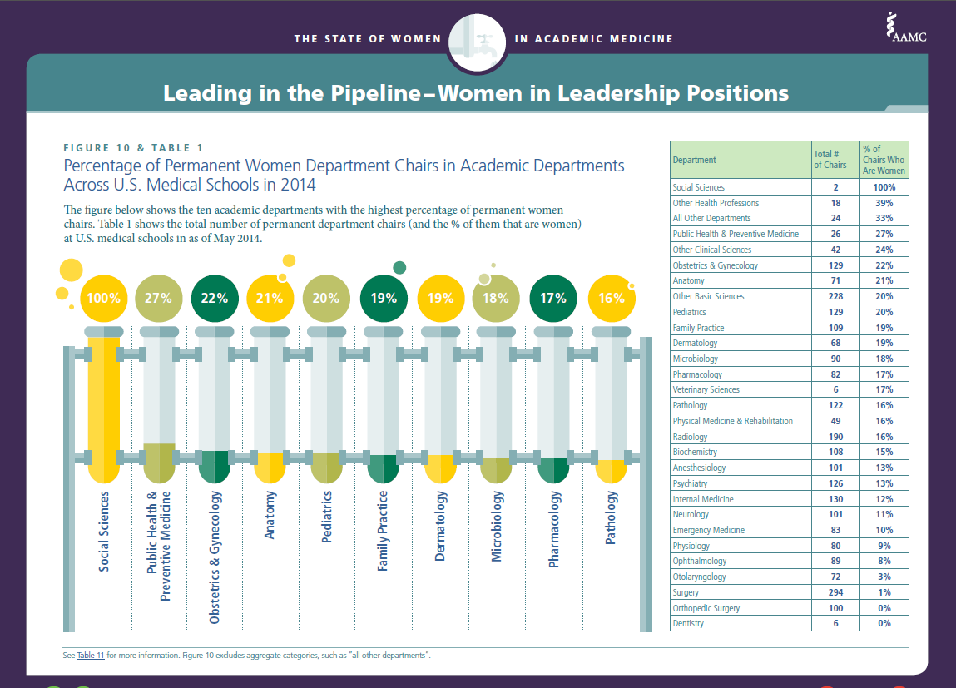
Notes:
This slide represents leadership in academic medicine. Recall that the largest representation of women faculty in academics is in medicine and then pediatrics. Note that the percent of department chairs who are women however, lags compared to the % in the field with 12% of all IM chairs being women and 20% of all pediatric chairs being women. Note also that the % of women faculty leaders in basic science departments is comparable to that of clinical departments despite a smaller percentage of women faculty in these fields……..why might this be the case?

Slide 17
Permanent Administrative Leadership Positions
*
*
2 of 17 clinical, 0 of 5 basic; 9 of 45 divisions
Source: Women in Medicine and Science Benchmarking Tables, Table 9a and 10a
Notes:
Consider the pathway to leadership – most traditional path is from division chief to department chair to vice dean or dean. Rarely is the assoc dean path one for advancement to dean.
The asst/assoc dean roles relate to education (nuturing), faculty (nuturing, behavior), research ($$) and clinical ($$)

Slide 18
What’s the Current State of Women in Academic Medicine and Science?
The proportion of female applicants applying to medical school has continued to drop since it peaked in 2003-04 (51% female applicants in 2003-04 to 46% female applicants in 2013-14).
Women make up 38% of all full time faculty.
The proportion of full professors who are women has increased 7 percentage points since 2004 (14%-22%), but the percentage of new tenured positions given to women has remained the same (30%).
The only academic rank with more women than men faculty is instructor.
Women continue to hold a significantly smaller number of key leadership positions
15% Department Chairs
16% Deans
Women are relatively well represented in deans office administrative roles
46% assistant deans
38% associate deans
34% senior associate deans
Notes:
Which of these paths are the path to senior leadership? Which are the paths that you and I find most desirable and satisfying?

Slide 19
What Women Say They Need To Succeed
The AAMC Faculty Forward Engagement Survey shows that women respond with high levels of engagement and satisfaction with:
Clear expectations about role and the path of advancement
An equitable and diverse workplace
Access to opportunities for development and advancement

Slide 20
This Issue is Not Unique to Academic Medicine
Women account for about half of law school grads and 36% of practicing lawyers.
Proportion of managers in U.S. commercial banks was 35% in 2014.
Proportion of managers in Investment Banking was 29% in 2000 and hasn’t changed since.
So there are lessons we can learn from the business literature.

Slide 21
We Need to Fix the Systems, Not the Women
Tenure track positions should be available for women faculty – and women should be encouraged to consider them.
Promotion and tenure timelines should be flexible to allow for conflicting work, life and family priorities
Support for women faculty to address:
Lack of self efficacy and self confidence
Feelings of marginalization and isolation
Insufficient mentoring
Women faculty need to be encouraged to build relationship capital
Structural support for writing, perhaps through peer mentoring

Slide 22
Target for addressing these issues
Conflicting work, life and family priorities
Family-friendly work policies
Paid maternity and paternity leave
Child care with hours that work for health care providers
Summer programming for children
Exercise facilities
Meetings during normal business hours
Lack of self efficacy and self confidence
Professional development programming
AAMC Early, Mid Career programs
AAMC Minority Faculty programs
ELAM
And programs need to include those that are not women only, like
Harvard ……
Networking

Slide 23
Target for addressing these issues
Addressing unconscious bias
Women receive significantly lower scores then men on RO1 renewals despite reviewer language ‘outstanding’, ‘excellent’
Despite the same level of grant support, women have fewer publications and lower H-index
Search committees
Feelings of marginalization and isolation
Invite women faculty to join you at the lunch table
Encourage your junior partners to take time for lunch!!
Make sure women and minorities are at the table during meetings
Failure to build relationship capital
Be intentional and sponsor women and male colleagues
Facilitate networking!

Slide 24
“Just because something is outside of awareness doesn’t mean it’s outside of control. Malcolm Gladwell, Blink”
Unconcious Bias training
Required training has been shown to potentially activate bias
The positive effects of diversity training rarely last beyond a day or two.
Male leaders with daughter(s) are more likely to close a gender pay gap and be attuned to women’s rights/needs in the workplace.
Notes:
Consider doing this sometime!!!!
Needs to be sure to include all departments in examples

Slide 25
Striving to achieve the need for: Clear expectations about their role and the path of advancement
Language in position descriptions should mirror the expectations for the job
Feedback verbiage in evaluations should be specific to actions, connecting contributions to business outcomes or to acknowledge technical expertise.
Letters of reference and recommendation should focus on leadership traits, not engendered behavioral traits.

Slide 26
Enhancing Visibility

Slide 27
Mentorship
Women report receiving less mentoring.
Perhaps women benefit more from a different type of mentorship?
Dyadic mentorship
Peer group mentor programs
Lean In circles
No data to support that women mentors are more effective for women faculty.
Engendered behaviors may also come into play here.

Slide 28
Sponsorship
“A Sponsor is someone who will make you visible to others, is willing to stick their neck out for you, introduce you to key players and put your name forward for opportunities……”
Women do not develop the same social capital as their male counterparts and are more frequently offered opportunities to sit on committees without financial impact…..

Slide 29
Networking
Women who were most proactive in making their accomplishments visible advanced further, were more satisfied with their career and had greater compensation growth than women less focused on calling attention to their success”
From the Catalyst Report 2011, "The Myth of the Ideal Worker”

Slide 30
The Lens You Use to View Your Experiences

Slide 31
How can we take action?
Encourage women faculty to consider the tenure track. Provide them, and their male colleagues with the necessary support to be successful in attaining tenure.
Unconscious bias training for search and P&T committees. Standard processes for all searches to reduce biases.
Develop policies, within the confines of your regulatory environment, that are family-friendly.
Assess progress regularly.
Training faculty to effectively mentor across genders.

Slide 32
How can we take action?
Focus on sponsorship for women faculty.
Find out how your faculty perceive the culture and climate of your department and the institution.
Empower men and women faculty to support, mentor, and sponsor each other.
Support women faculty in national professional development opportunities throughout the career lifecycle as allowable. Work to have them share knowledge and experiences.
Notes:
Bullet point 2 – How can the Faculty Forward survey inform this discussion?

Slide 33
Think about the right balance and strive to achieve it.
A culture conducive to women’s academic success would include:
Freedom from gender bias
Equal access to opportunities
Chair/Chief support
Support for work-life balance

Slide 34
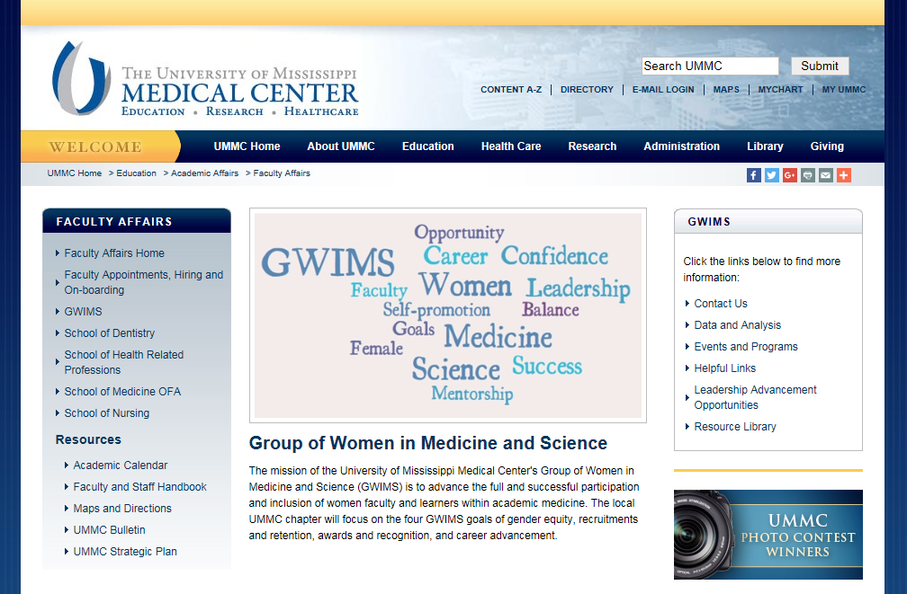
https://www.umc.edu/gwims/

Slide 35
Questions??

